Slide 1
Using the QRProblem Homework Site
For Students

Slide 2
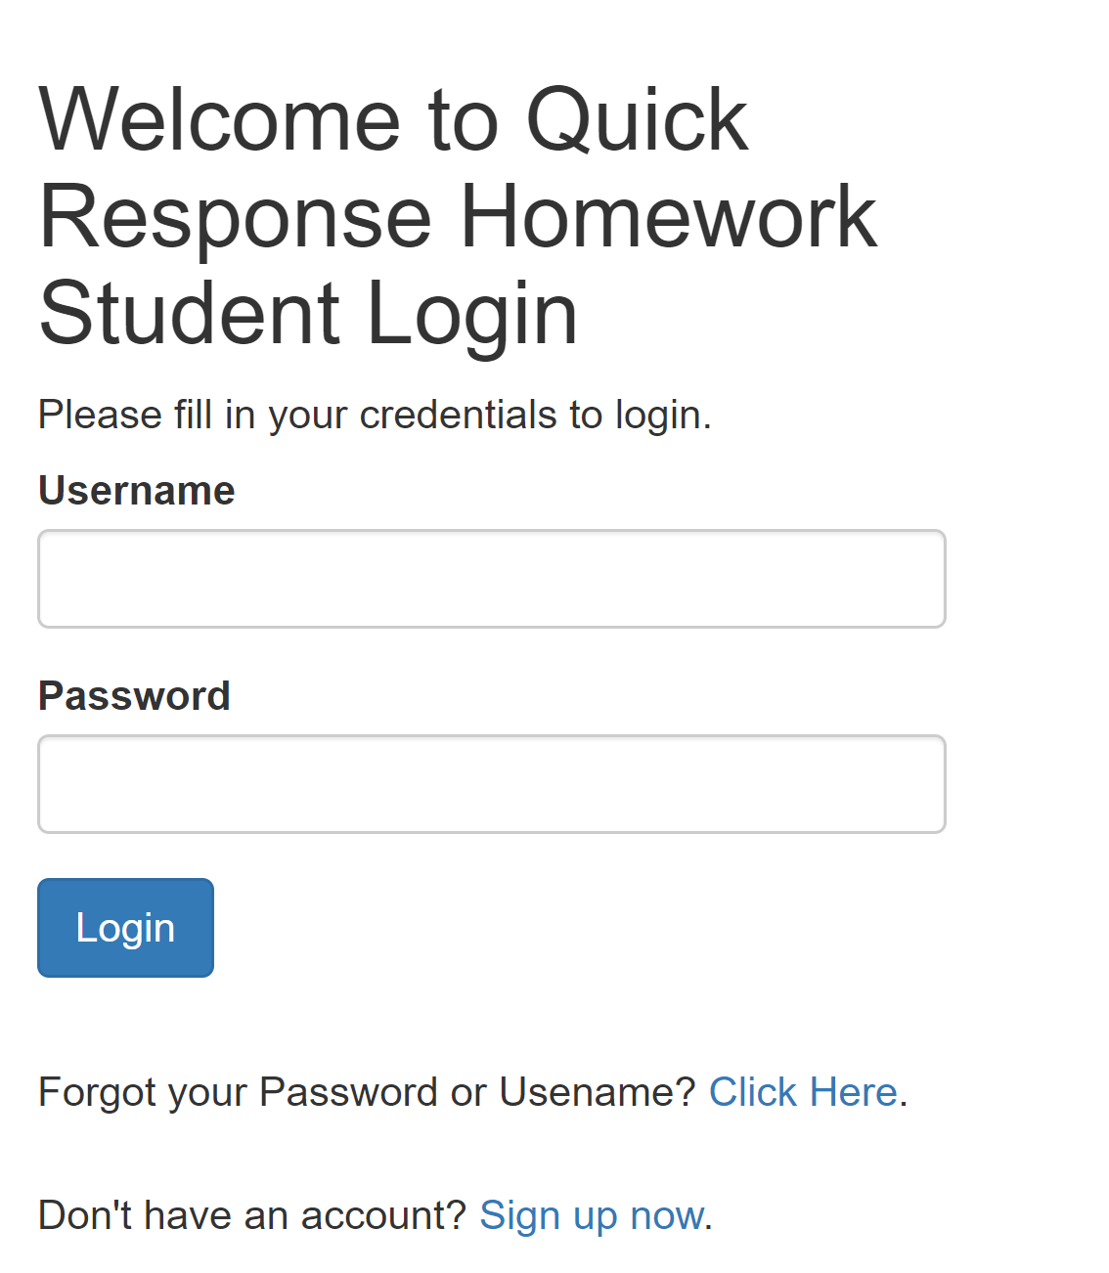


Go to QRhomework.org

Slide 3
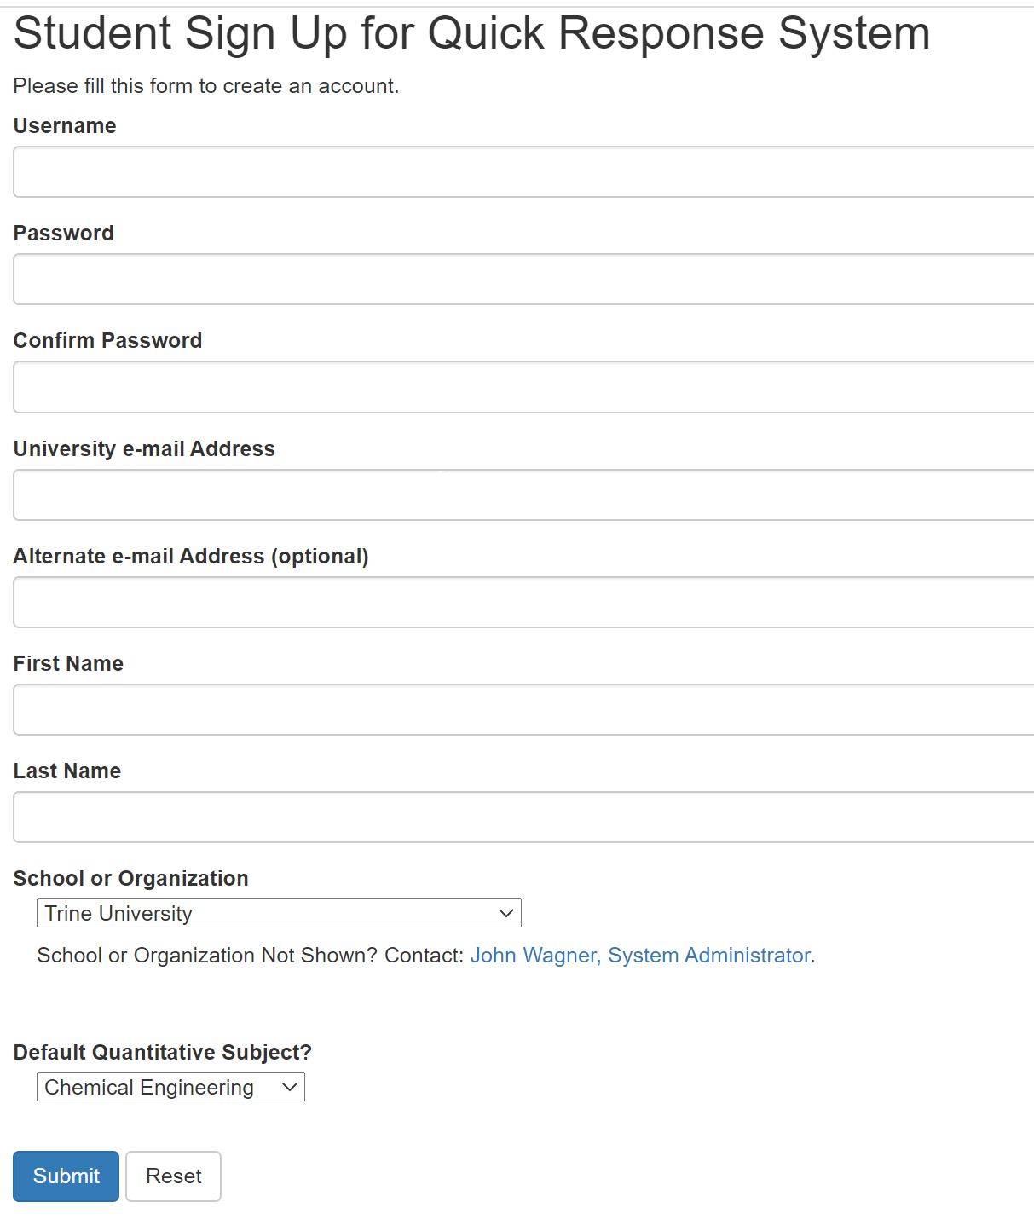
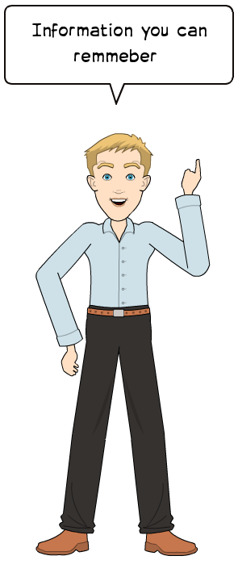
Standard Sign in form

Slide 4
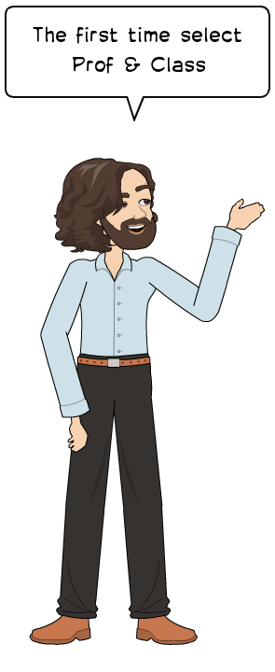
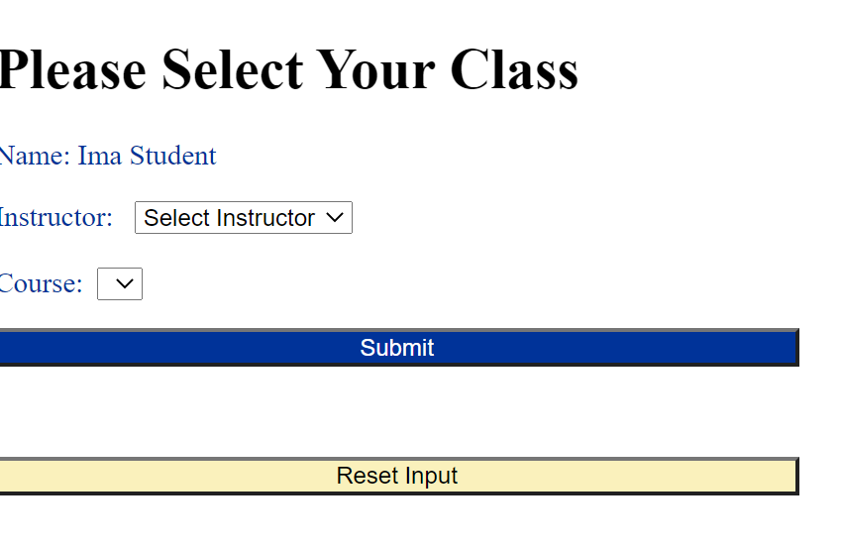

Slide 5
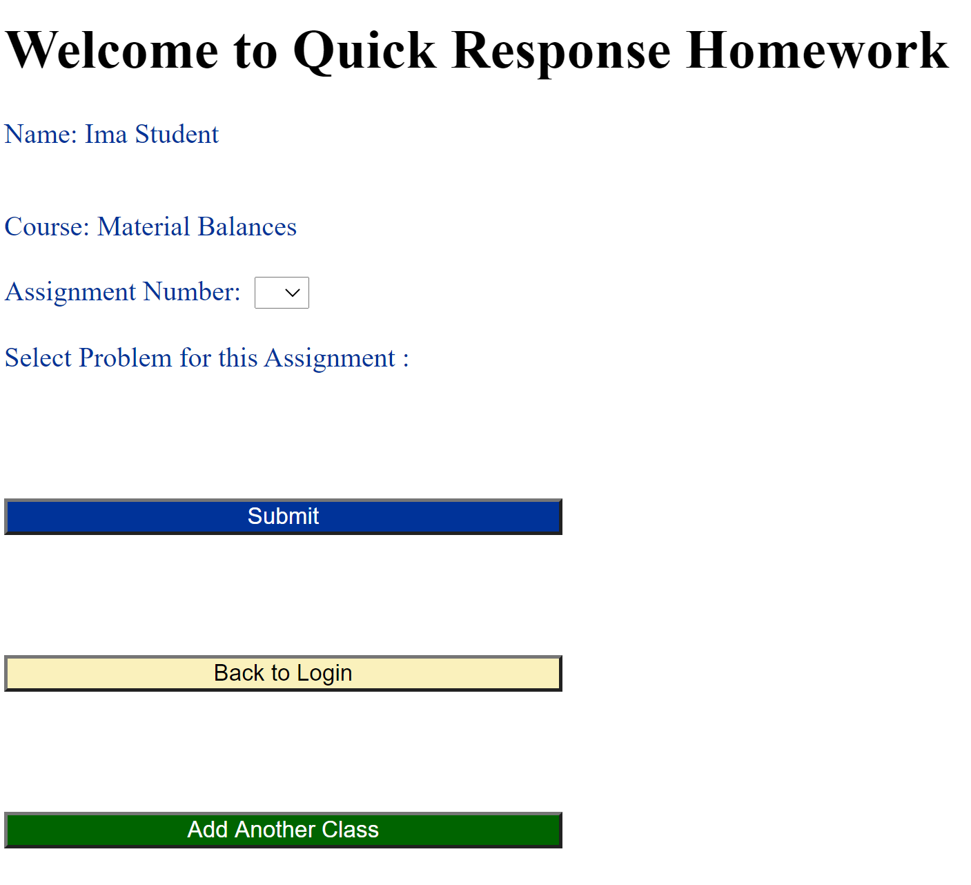
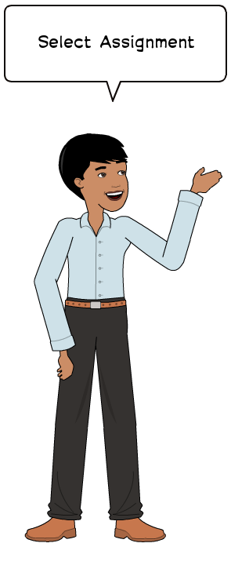
Only if you have more than one class with
QRhomeowrk

Slide 6
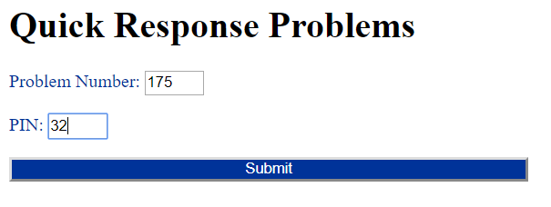
Print the problem out using ctrl P (or equivalent)
Get problem checker (on your phone or computer) by scanning the QR code or at:
QRProblems.org/prob

Slide 7
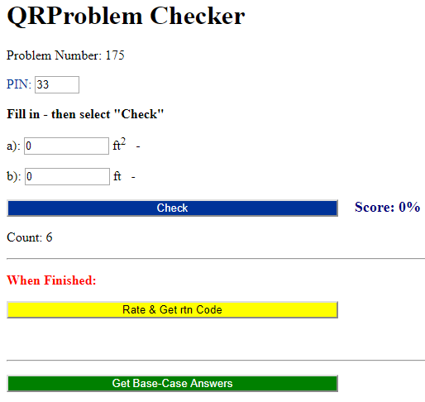
Work the problem and put your responses in the checker
If you get a part incorrect more than 3 or 4 times you should see a link to a hint pop up.
If you get stuck, you can work the base-case problem. Answers to the base-case are here

Slide 8
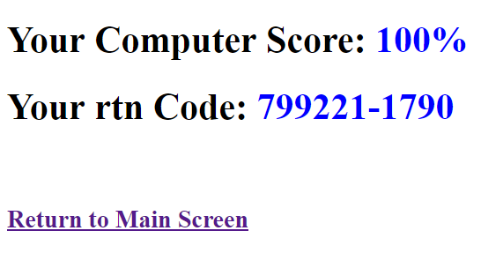
When you are satisfied with your score press “get rtn-Code”
Copy by hand the score and the rtn Code onto the printed-out problem statement and finish any of the reflection questions that were assigned

Slide 9

Good Luck – I hope you like the system

